Slide 1
AP Macro Final Exam

Slide 2
Statistics S1
AP Exam Discussion
AP Exam questions are harder than the quizzes.
The questions are not in order so your brain has to jump around – more difficult.
You have to answer pretty quickly for the MC.
The real AP exam has 60 questions in 70 minutes.
Averages:
Raw Score: 69.8%
MC Average: 33.6/50
FR Average: 22.7/30
Curved Average: 88.4
Notes from this semester
Don’t just focus on quizzes and correcting your quizzes
You still need to do more practice questions, especially the AP practice questions to have a strong understanding
Make sure you revise your Unit 3 – it will be impossible to succeed without good knowledge of Unit 3
You will be left behind!
Unit 4 is also important – revise this in areas you are weak
AP Exam Scores and Percentages
73-90/90 is 5 = 81%
58-72/90 is 4 = 64%
50-57/90 is 3 = 55%
39-49/90 is 2 = 43%
0-38/90 is 1 = 42% and below

Slide 3
Statistics S3
AP Exam Discussion
AP Exam questions are harder than the quizzes.
The questions are not in order so your brain has to jump around – more difficult.
You have to answer pretty quickly for the MC.
The real AP exam has 60 questions in 70 minutes.
Averages:
Raw Score: 81.7
MC Average: 41.4/50
FR Average: 23.8/30
Curved Average: 90.1
Preparing for the AP Exam
We have two more units to go which build a lot on previous units.
Essential!
If you have weakness in anything from Unit 3, then you need to revise it. – you are unlikely to succeed in the rest of the course if you don’t master Unit 3
Important
Make sure you understand Unit 4 as well. Monetary Policy and Money Markets especially

Slide 4
MC questions
Full Explanation of FR is below, I will provide in group chat

Slide 5
Poorly Answered MC Questions
6
11
19
20
21
22
26
31
32
43
44

Slide 6
Free Response
Give yourself more space on the paper!
Annoying to grade.
Restricts your thinking and slows you down.
Leads to incomplete answers, unclear graphs etc.
When the question says ‘Explain’ you have to give a reasonable explanation of the causes of certain events.
Don’t just say SRAS will shift to the left. Explain why it shifts.
Don’t just say increase of tax, explain why the tax increases.

Slide 7
FR Question 1
The economy of Zarland is operating below the full-employment level of output with a balanced budget.
(a) Draw a correctly labeled graph of short-run aggregate supply, long-run aggregate supply, and aggregate demand, and show each of the following. (5 marks)
(i) The country’s current equilibrium output and price level, labeled Y1 and PL1, respectively
(ii) The full-employment output, labeled Yf
(b) If Zarland increases government expenditures and taxes by equal amounts, can aggregate demand increase? Explain. (1.5 marks)
(c) If Zarland decides to pursue an expansionary monetary policy, what open-market operation should the central bank undertake? (1.5 marks)
(d) Using a correctly labeled graph of the money market, show the short-run effect of the open-market operation you identified in part (c) on the interest rate. (2 marks)

Slide 8
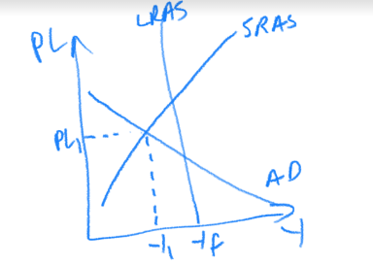
(a) Draw a correctly labeled graph of short-run aggregate supply, long-run aggregate supply, and aggregate demand, and show each of the following. (5 marks)
(i) The country’s current equilibrium output and price level, labeled Y1 and PL1, respectively
(ii) The full-employment output, labeled Yf

Slide 9
(b) If Zarland increases government expenditures and taxes by equal amounts, can aggregate demand increase? Explain. (1.5 marks)
Yes, because government spending has the normal spending multiplier (1/MPS) which is larger than the effect of tax which has the tax multiplier (-MPC/MPS).

Slide 10
(c) If Zarland decides to pursue an expansionary monetary policy, what open-market operation should the central bank undertake? (1.5 marks)
Expansionary MP = Increase AD by lowering the interest rate
This can be done by increasing the MS.
Open Market Operations = buy and sell bonds
Buy big, sell small
Therefore the central bank should buy bonds.

Slide 11
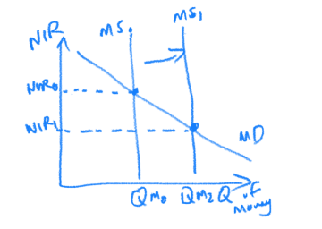
(d) Using a correctly labeled graph of the money market, show the short-run effect of the open-market operation you identified in part (c) on the interest rate. (2 marks)
Increase MS -> Decrease of the IR

Slide 12
FR Question 2
Assume that the current unemployment rate in Zeeland is lower than the natural rate of unemployment. (12 marks)
(a) Draw a single correctly labeled graph AD/AS graph, showing the equilibrium point labeled A. Label the equilibrium output Y₀ and equilibrium price level PL₀. (4 marks)
(b) Draw a PPC, showing the same point A labeled correctly. (1.5 marks)
(c) Draw a fully labeled Business Cycle graph that also shows point A correctly. (1.5 marks)
(d) Identify a specific fiscal policy action that would bring the economy to full employment. (1.5 marks)
(e) What effect would occur if the government were to not take any discretionary fiscal policy action? Explain. (1.5 marks)
(f) Now assume instead that there is no fiscal policy action. What would be the long run effect on the economy? Explain. (2 marks)

Slide 13
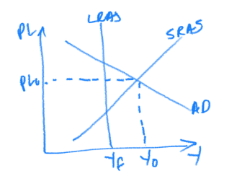
(a) Draw a single correctly labeled graph AD/AS graph, showing the equilibrium point labeled A. Label the equilibrium output Y₀ and equilibrium price level PL₀. (4 marks)
UR<NRU, therefore Yactual > Ypotential, therefore positive output gap/inflationary gap

Slide 14
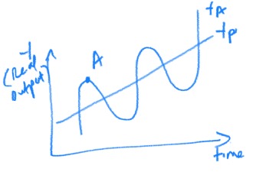
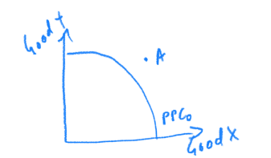
(b) Draw a PPC, showing the same point A labeled correctly. (1.5 marks)
(c) Draw a fully labeled Business Cycle graph that also shows point A correctly. (1.5 marks)

Slide 15
(d) Identify a specific fiscal policy action that would bring the economy to full employment. (1.5 marks)
Because economy is in an inflationary gap/positive output gap, the fiscal policy will be contractionary.
Therefore: Increase Tax, Decrease gov spending, Decrease gov transfers

Slide 16
(e) What effect would occur if the government were to not take any discretionary fiscal policy action? Explain. (1.5 marks)
The clue is in the mention of discretionary fiscal policy. This means the question is asking about non-discretionary fiscal policy. This means automatic stabilizers.
In a positive output gap, automatic stabilizers will reduce AD.
This is because an inflationary gap has an increase in RGDP and real incomes, therefore tax collected will be higher and gov transfers such as social security will be lower.
This will lead to reduced spending and reduce AD. It will move the economy back closer to Yp.

Slide 17
(f) Now assume instead that there is no fiscal policy action. What would be the long run effect on the economy? Explain. (2 marks)
Clues to the question:
No fiscal policy
Long Run effect
Therefore the question is talking about macro self adjustment (SRAS shifts)
In an inflationary gap, the price level is higher.
In the long run, when wages/resource costs are flexible, this will cause an increase in the price of resources which will decrease SRAS (shift left).

Slide 18
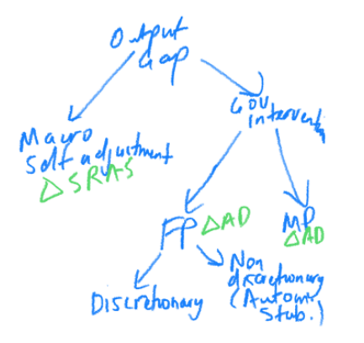

Slide 19
FR Question 3
United Bank Balance Sheet
Liabilities | Assets
Demand Deposits $10,000 | Required Reserves $2000 Excess Reserves $1000 Loans $7000
Use the following balance sheet to answer the following questions.
A) Suppose a customer deposits an extra $3000 in United Bank. What is the maximum amount of extra loans that the United Bank can now create?
B) What is the total maximum change to the money supply if United Bank and all banks within the banking system choose to lend out the maximum amount of loans?
C) What is the total change in deposits in the banking system as a result of actions from part b)?
D) What is the total change in money supply as a result of a purchase of government securities by the Federal Reserve of $5000?

Slide 20
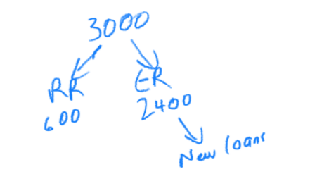
United Bank Balance Sheet
Liabilities | Assets
Demand Deposits $10,000 | Required Reserves $2000 Excess Reserves $1000 Loans $7000
A) Suppose a customer deposits an extra $3000 in United Bank. What is the maximum amount of extra loans that the United Bank can now create?
RRR = 2000/10000 = 0.2
RR = 0.2 x 3000 = 600
ER = 3000 -600 = 2400
ER is the maximum amount of extra loans that the bank can make. Therefore 2400

Slide 21
United Bank Balance Sheet
Liabilities | Assets
Demand Deposits $10,000 | Required Reserves $2000 Excess Reserves $1000 Loans $7000
What is the total maximum change to the money supply if United Bank and all banks within the banking system choose to lend out the maximum amount of loans?
This question is a bit unclear, because there is already 1000 in excess reserves.
So I accepted two answers:
1. The 2400 from the deposit that went into ER is loaned through the banking system.
Change of MS = original loans from United Bank x MM
Therefore 2400 x 1/0.2 = 12000
2. If you included the 1000 of ER already in there, then 2400+1000 = the max loans from United Bank was 3400.
Change of MS = original loans from United Bank x MM
Therefore 3400 x 1/0.2 = 17000
Many students also included the 7000 of existing loans, but this money has already been loaned through the system and so is already counted in money supply. The question is asking for the CHANGE in money supply.

Slide 22
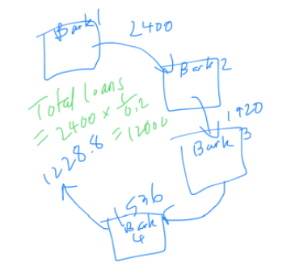

Slide 23
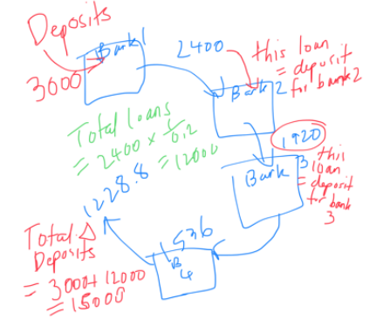
United Bank Balance Sheet
Liabilities | Assets
Demand Deposits $10,000 | Required Reserves $2000 Excess Reserves $1000 Loans $7000
What is the total change in deposits in the banking system as a result of actions from part b)?
This question is also unclear because I meant the change from part a) and b) together.
Therefore change deposits = original deposit + change of loans in the system (Remember, that loans from one bank become deposits in the next bank)
= 3000 + 2400 x MM = 15000
(I would have accepted other answers if you used this method of adding the original deposit + the change of loans)

Slide 25
What is the total change in money supply as a result of a purchase of government securities by the Federal Reserve of $5000?
Remember: Buy big
Therefore when the Federal Reserve buys $5000 of bonds, this brings new money into the money supply. Therefore MS increases by $5000.
This money will then be lended through the banking system, creating more money also.
When the 5000 is deposited in the first bank, only 4000 (RRR = 0.2) will be able to loaned. Therefore change of loans in system = 4000 x 1/0.2 = 20,000.
Total change = original amount that wasn’t in MS + change of loans = 5000 + 20,000 = 25000

Slide 26
